Slide 1
Participants
Inclusion criteria:
30 to 100 years old
Record of COVID-19 diagnosis between 23rd January 2020 to June 29th, 2022
>1year of clinical history in GDPPR (GP data)
Study period: from January 23rd, 2020 (first documented case of COVID-19 in the UK) to June 29th, 2022
COVID-19 death definition: death within the following 28 days after COVID-19 diagnosis and: - (i) record of an ICD-10 term for suspected or confirmed COVID-19 diagnosis on the death certificate, - (ii) death within 28 days from first recorded COVID-19 event (positive test, diagnosis, or admission ),
- or (iii) hospital admission due to COVID-19 plus a discharge method or destination indicating death, regardless of cause and up to a duration of 90 days after the index date.
Notes:
COVID-19 death was defined as date of death within the following 28 days after COVID-19 diagnosis and (i) record of an ICD-10 term for suspected or confirmed COVID-19 diagnosis on the death certificate, (ii) death within 28 days from first recorded COVID-19 event (positive test, diagnosis, or admission ), or (iii) hospital admission due to COVID-19 plus a discharge method or destination indicating death, regardless of cause and up to a duration of 90 days after the index date (date of COVID-19 diagnosis).

Slide 2
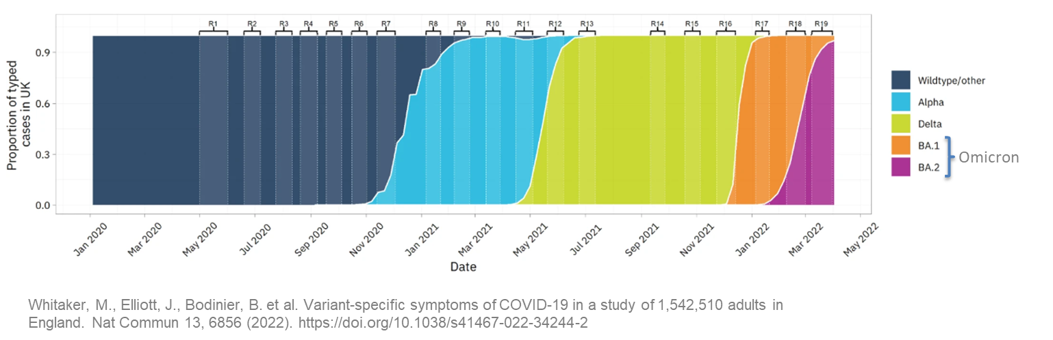
- End date of study
11 June: No PCR+ confirmation required
Study period
1 Dec 2020
(Omicron start)
Start date
23 Jan 2020
21 Dec
(Alpha)
31 May
(Delta)
19 June
(Wild type)
29 June
2020
2021
2022
End data availability

Slide 3
Outcomes of the study
COVID-19 mortality at two end points:
28-days COVID-19 mortality: death within 28 days from covid-19 diagnosis
90-days COVID-19 mortality: death within 90 days from covid-19 diagnosis
Short and long term Cardiovascular Events (CVE):
30-days CVE: CVE within next 30 days after covid-19 diagnosis
1-year CVE: CVE within next 1-year after covid-19 diagnosis

Slide 4
Outcomes of the study
Terms included in Cardiovascular Events (CVE):
Abdominal aortic aneurysm
Atrial fibrillation
Atrioventricular block complete
Atrioventricular block first degree
Atrioventricular block second degree
Bifascicular block
Coronary heart disease not otherwise specified
Dilated cardiomyopathy
Heart failure
Hypertrophic cardiomyopathy
Intracerebral haemorrhage
Ischaemic stroke
Left bundle
Branch block
Myocardial infraction
Other cardiomyopathy
Pericardial effusion non-inflammatory
Peripheral arterial disease
Primary pulmonary hypertension
Pulmonary embolism
Raynaud's syndrome
Rheumatic valve dz
Right bundle branch block
Secondary pulmonary hypertension
Sick sinus syndrome stable angina
Stroke (NOS)
Subarachnoid haemorrhage
Subdural hematoma non-traumatic
Supraventricular tachycardia
Transient ischaemic attack
Trifascicular block
Unstable angina
Venous thromboembolic disease (excluding PE)
Ventricular tachycardia
We excluded hypertension from CVE

Slide 5



Ethnicity categories
1. High-level ethnic groups
2. Ten-level ethnic groups
Asian
Black
Mixed
White
Other
Unknown
Indian
Pakistani
Bangladeshi
Chinese
African
Caribbean
Mixed
White British
White Other
Other
3. NHS ethnicity codes (19 ethnic groups)
4. SNOMED-CT concepts for ethnicity
A | British (White)
B | Irish (White)
C | Any other White background
D | White and Black Caribbean (Mixed)
E | White and Black African (Mixed)
F | White and Asian (Mixed)
G | Any other Mixed background
H | Indian (Asian or Asian British)
J | Pakistani (Asian or Asian British)
K | Bangladeshi (Asian or Asian British)
L | Any other Asian background
M | Caribbean (Black or Black British)
N | African (Black or Black British)
P | Any other Black background
R | Chinese (other ethnic group)
S | Any other ethnic group
W | Arab
T | Gypsy/Irish Traveller
Z | Not stated
489 different concepts available
CVE, cardiovascular event

Slide 6
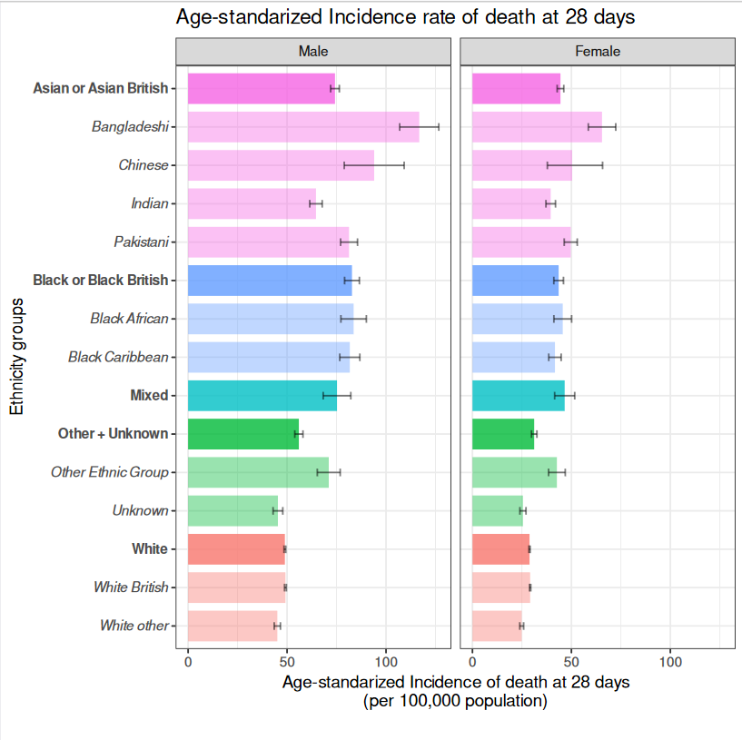
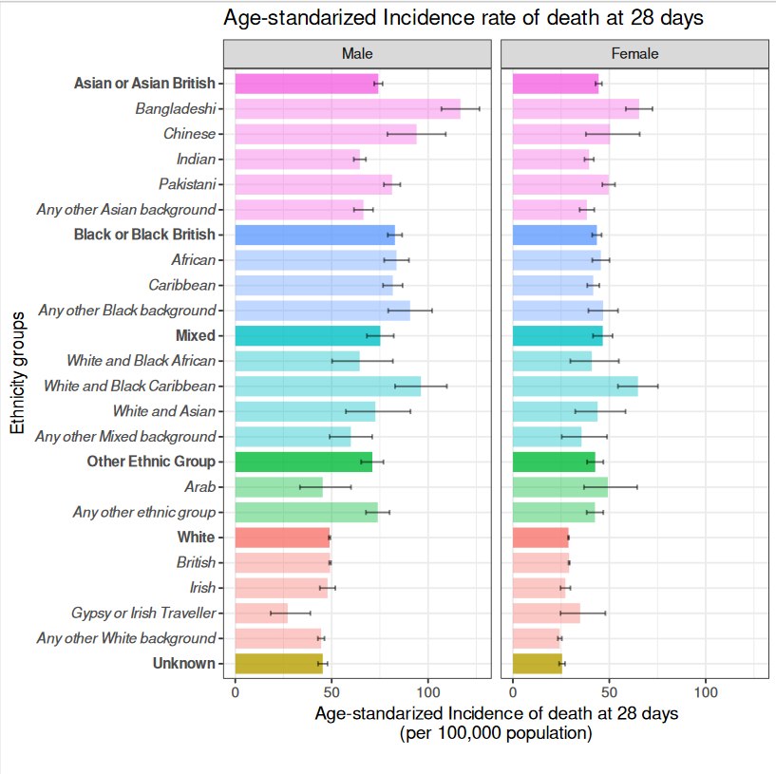
Age-standardized Incidence Rates in 5 ONS Ethnicity Groups and 19 Sub-groups
28 days COVID-19 mortality:
High-level vs Ten-level ethnic groups
High-level ethnic groups vs NHS ethnicity codes
Ref.
Ref.
Ref.
Ref.
Notes:
Male and female, all to date from 2020 to 2022, Bangladesh in lead followed by Chinese and Pakistan

Slide 7
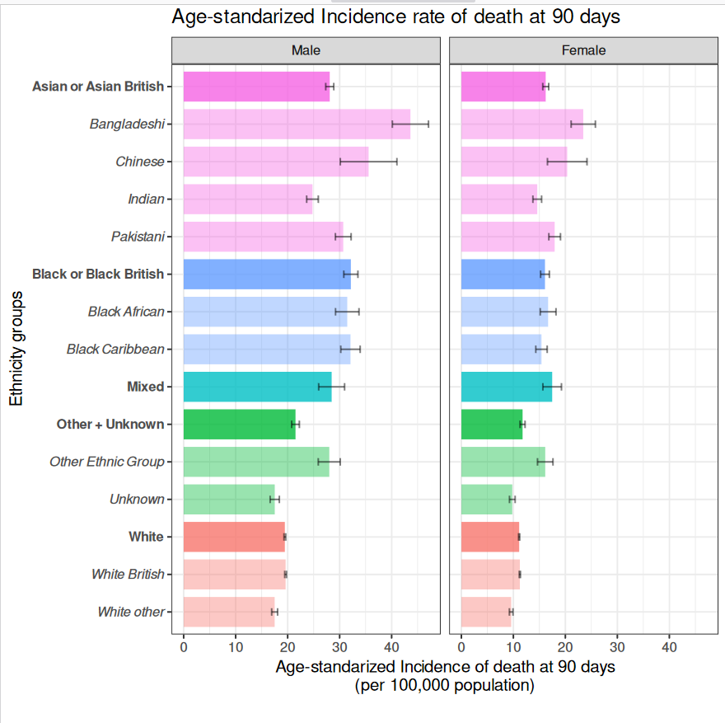
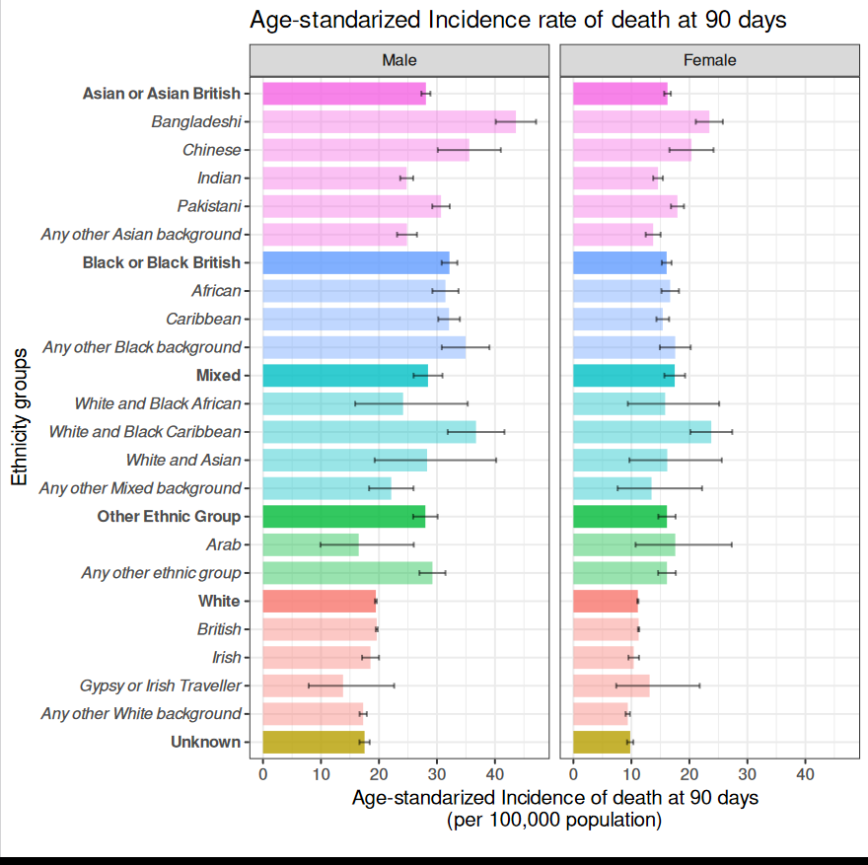
Age-standardized Incidence Rates in 5 ONS Ethnicity Groups and 19 Sub-groups
90 days COVID-19 mortality:
High-level vs Ten-level ethnic groups
High-level ethnic groups vs NHS ethnicity codes
Ref.
Ref.
Ref.
Ref.

Slide 8
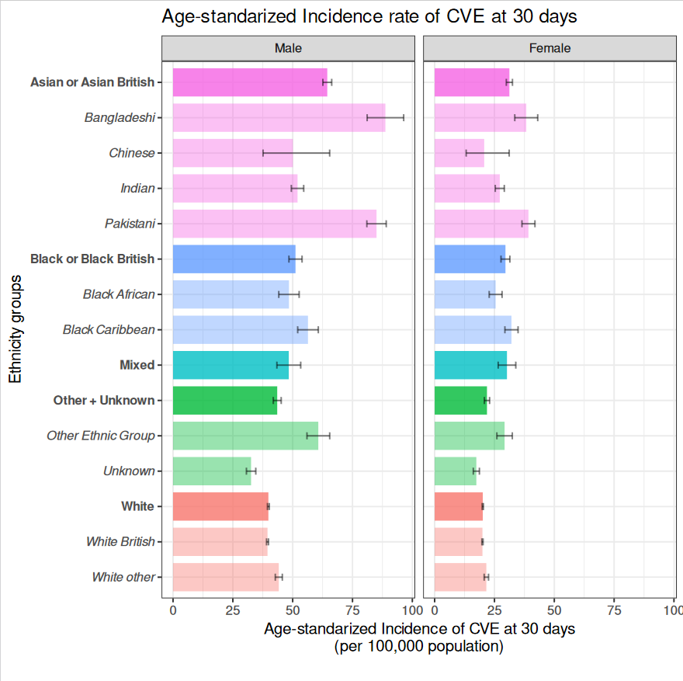
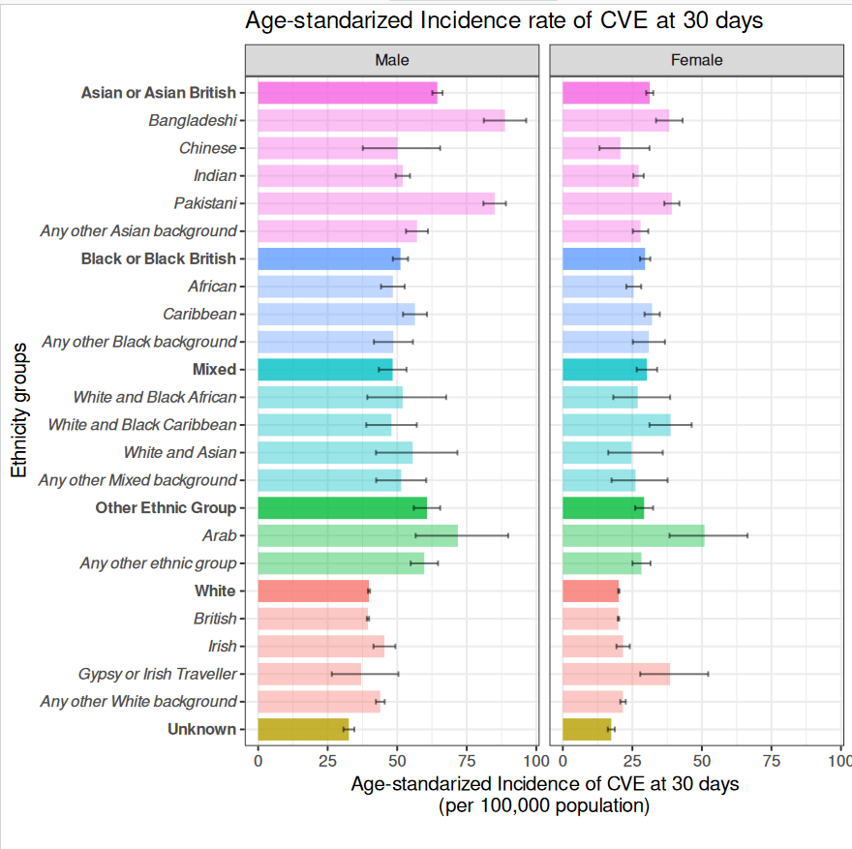
Age-standardized Incidence Rates in 5 ONS Ethnicity Groups and 19 Sub-groups
30 days CVE:
High-level vs Ten-level ethnic groups
High-level ethnic groups vs NHS ethnicity codes
Ref.
Ref.
Ref.
Ref.
Notes:
Bang and pak in lead

Slide 9
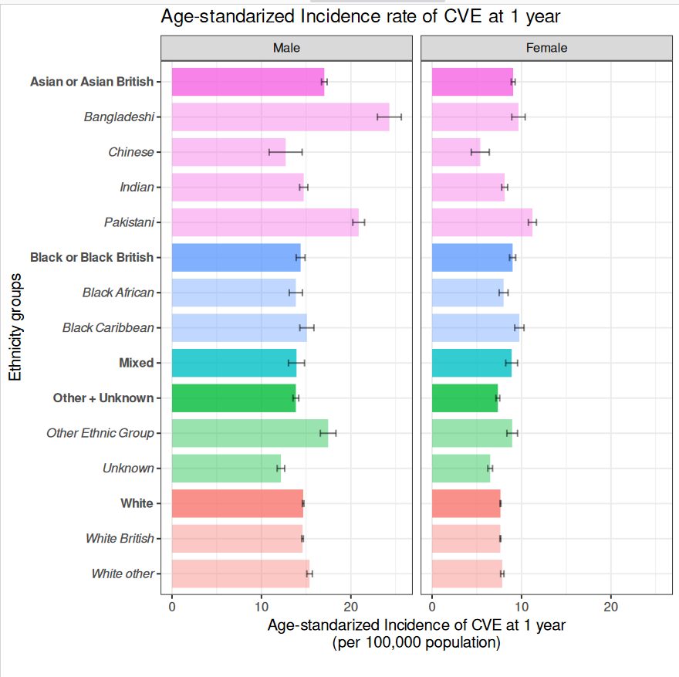
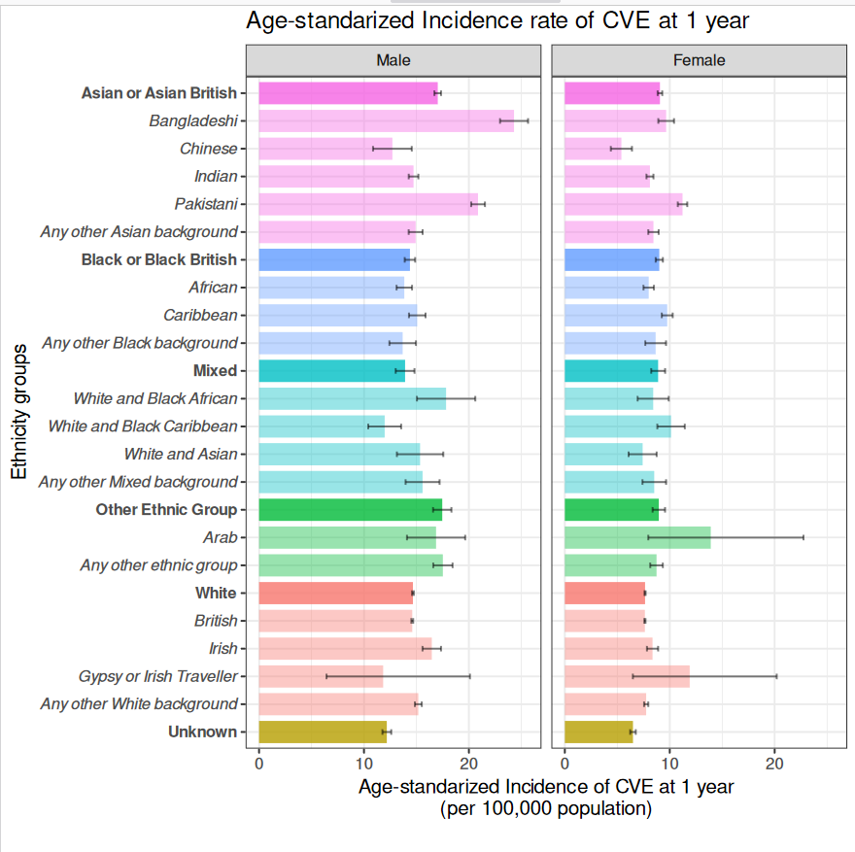
Age-standardized Incidence Rates in 5 ONS Ethnicity Groups and 19 Sub-groups
1-year CVE:
High-level vs Ten-level ethnic groups
High-level ethnic groups vs NHS ethnicity codes
Ref.
Ref.
Ref.
Ref.
Notes:
How is IR calculated?

Slide 10
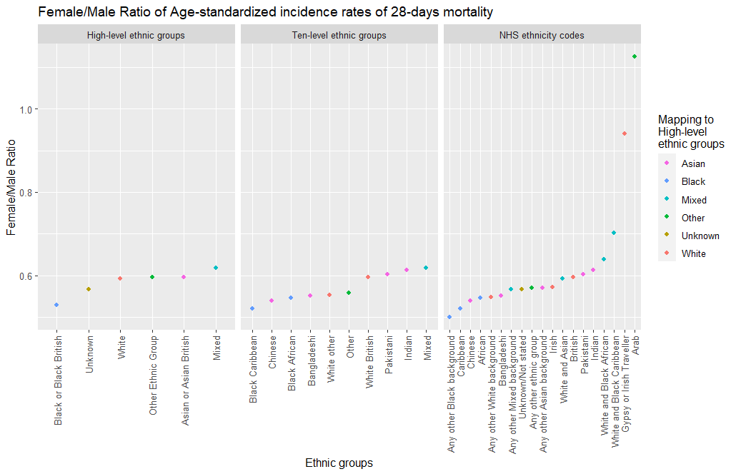
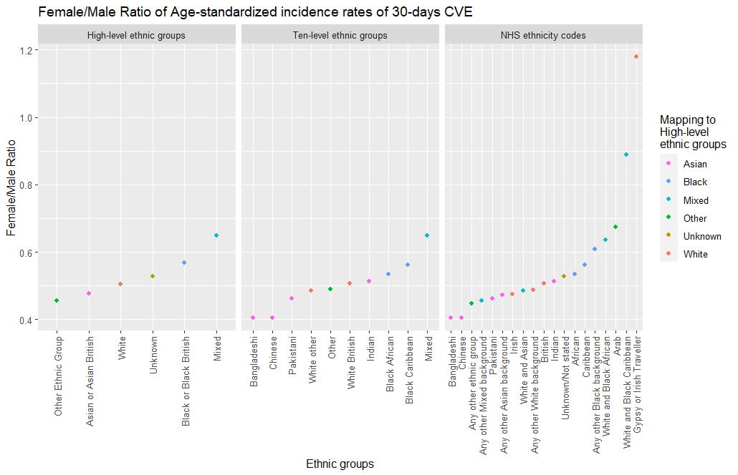
Gender differences
IR CI overlap
Arab n = 5,435 (20/20 deaths)
Gypsy or Irish Traveller n = 3,340 (15/15 CVE)
Higher ratios than male
Lower ratios than male
Higher ratios than male
Lower ratios than male
The ratio between “female IR/ male IR” variates across different ethnic groups.

Slide 11
SNOMED Ethnicity categories
Exploring more granular ethnicity categories within
Asian or Asian British
Black or Black British
Other Ethnic Group
- And compare with White group

Slide 12
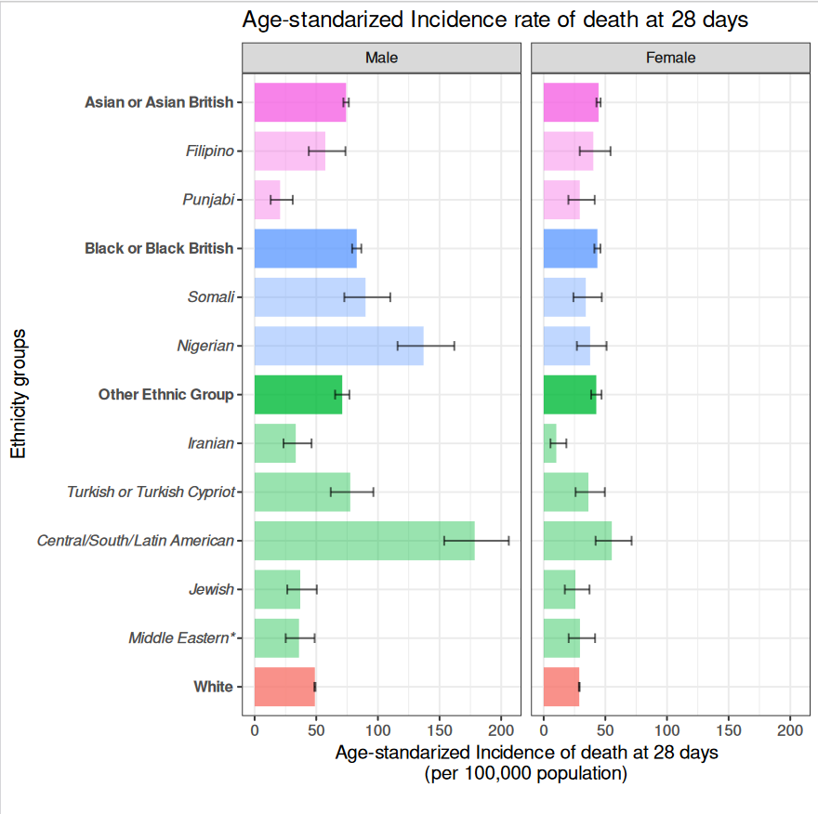
Age-standardized Incidence Rates: looking deeper into 19 sub-groups >=1000 individuals
28 days COVID-19 mortality:
High-level vs SNOMED ethnic groups
Ref.
Ref.
Middle eastern* = excluding Israeli, Iranian and Arab.
Notes:
Almost all deeper/minor groups exceed white, as well as their parent groups

Slide 13
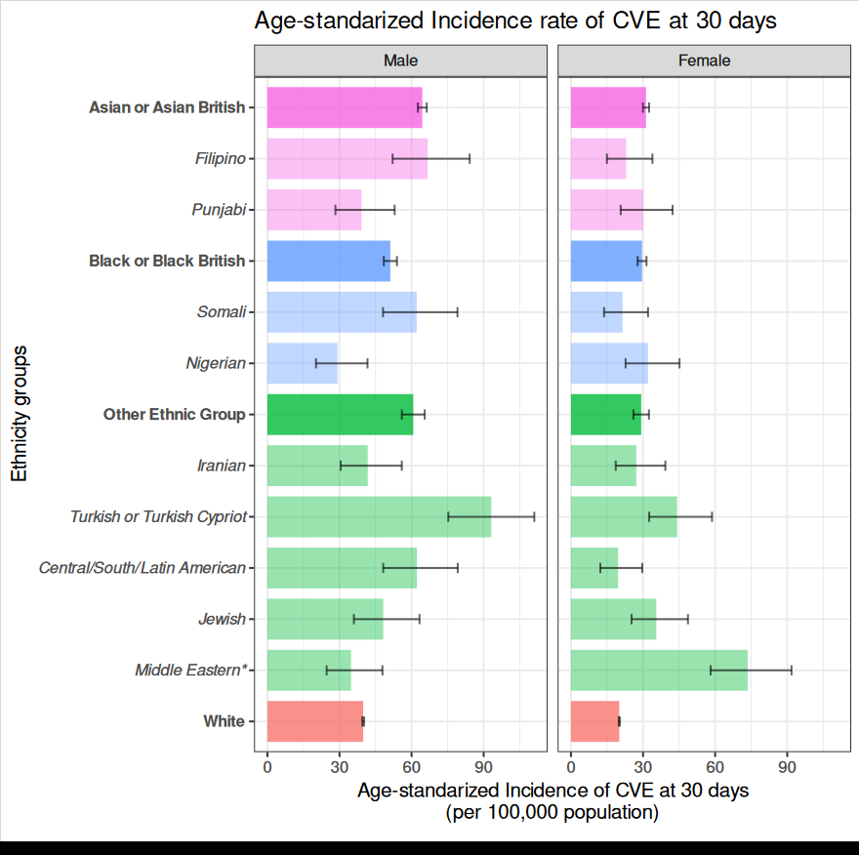
Age-standardized Incidence Rates: looking deeper into 19 sub-groups >=1000 individuals
30-days CVE:
High-level vs SNOMED ethnic groups
Ref.
Ref.
Middle eastern* = excluding Israeli, Iranian and Arab.

Slide 14
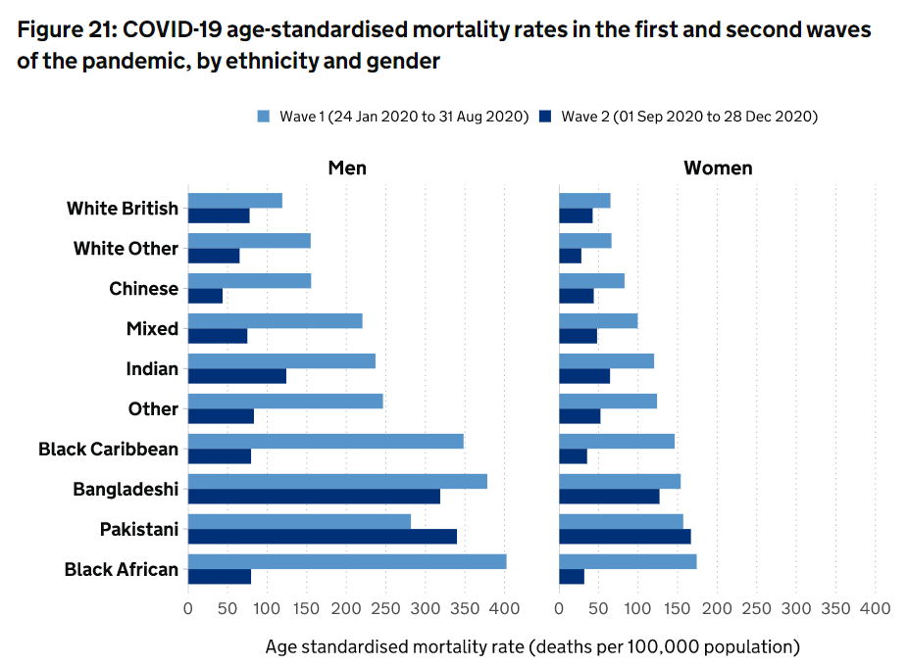

Prior findings show differences in mortality rates over time
Font:
Notes:
Figure font: https://www.gov.uk/government/publications/the-report-of-the-commission-on-race-and-ethnic-disparities/health#covid-19

Slide 15
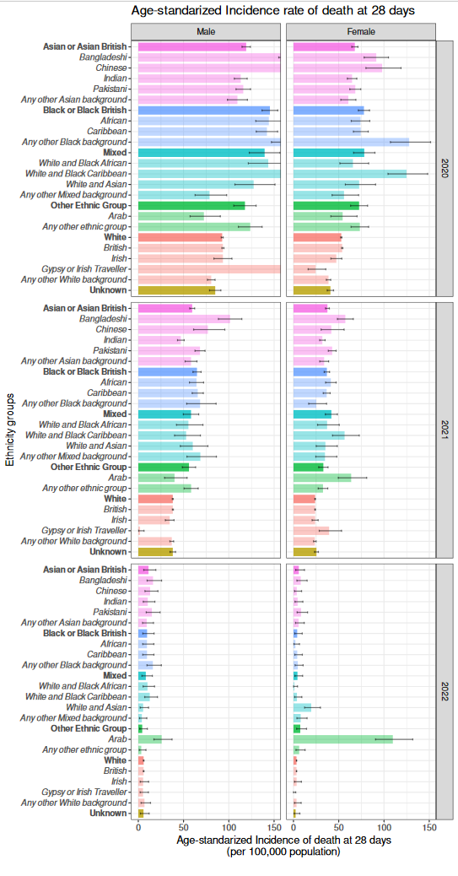
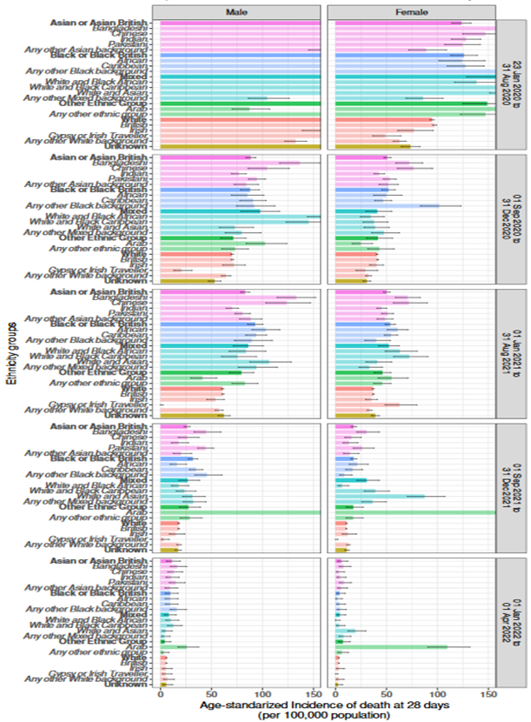
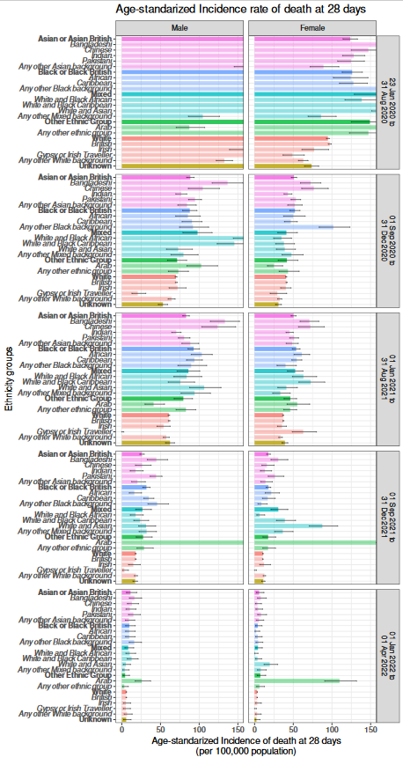
Age-standardized Incidence Rates
28 days COVID-19 mortality by years of COVID-19 diagnosis:
High-level ethnic groups vs NHS ethnicity codes
COVID-19 diagnosis per year
COVID-19 diagnosis every 6-month

Slide 16
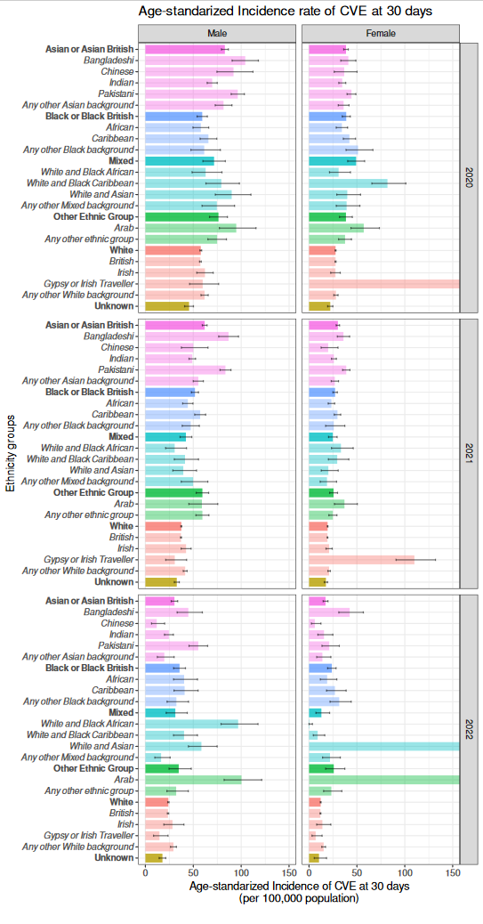
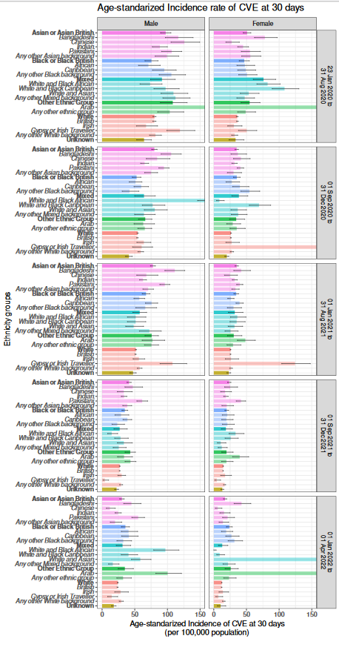
Age-standardized Incidence Rates
30 days CVE by years of COVID-19 diagnosis:
High-level ethnic groups vs NHS ethnicity codes
COVID-19 diagnosis per year
COVID-19 diagnosis every 6-month

Slide 17
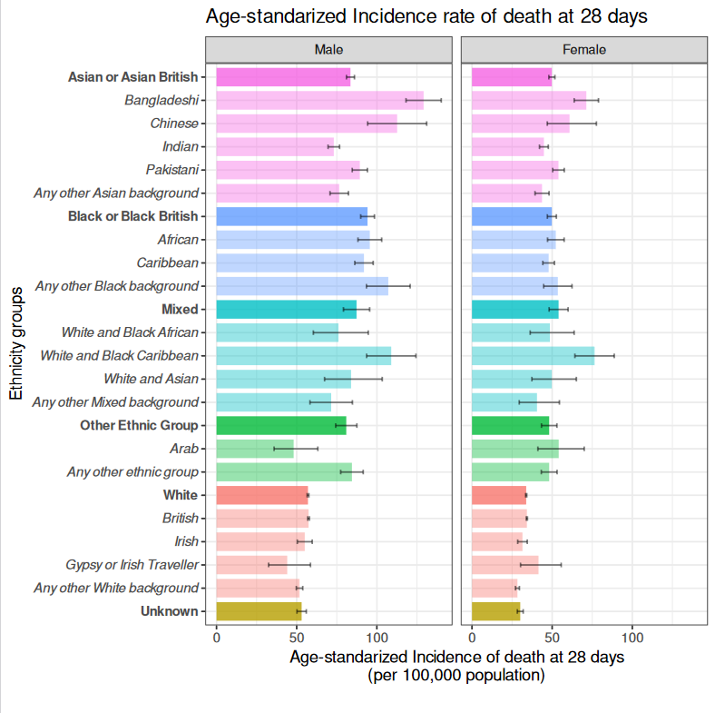
- End date of study
Period selected: Jan 2020 to 29 June 2022 (“All”) Jan 2020- Dec 2021 (“Clean”)
<125
>125
<100
>100
<75
≈75
≤50
>50

Slide 18
- End date of study

Slide 19
Summary
Overall trends in line with previous work, cross-sectionally and over time
CVD, mortality IR higher in Asian males (Bangladeshi & Pakistani)
CVD, mortality IR in deeper/sub-groups (e.g. Filipino, Somali, higher than White and own parent group, previously unreported

